Slide 1
CSE 453
High Performance Database Systems
Course Teacher : Md Tarikul Islam Papon

Slide 2
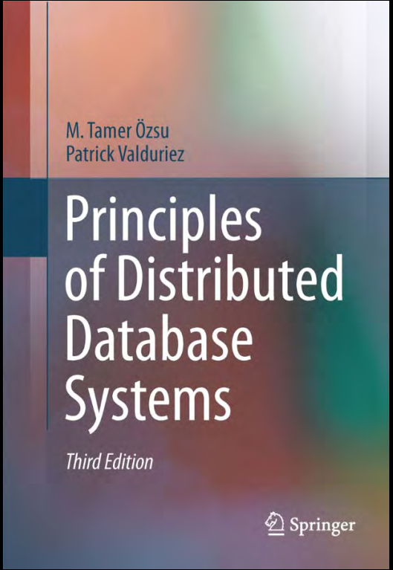

Reference Book

Slide 3
Course Assessment
Criteria | Weight
Attendance | 10%
Class Tests | 20%
Term Final | 70%

Slide 4
Class Tests
Three/Four class tests will be held
In addition, you all have to write a review of a/some sample paper(s).

Slide 5
Motivation Behind this Course
Nowadays, data is everywhere.
Every day, we create 2.5 exabytes of data : 90% of the data in the world today has been created in the last two years alone.
-[Understanding Big Data, IBM]
Storing, processing and analysis of this “Big Data” is not straight-forward.
We need our database system to be on top its game!!!

Slide 6
Data is Everywhere
Business: Web, e-commerce, transactions, stocks, …
Science: Remote sensing, bioinformatics, scientific simulation, …
Search engine: web searches…
Medical and health industry: Medical records, patient monitoring, and medical imaging, …
Communication and social media: news, digital cameras, YouTube, social networks…

Slide 7
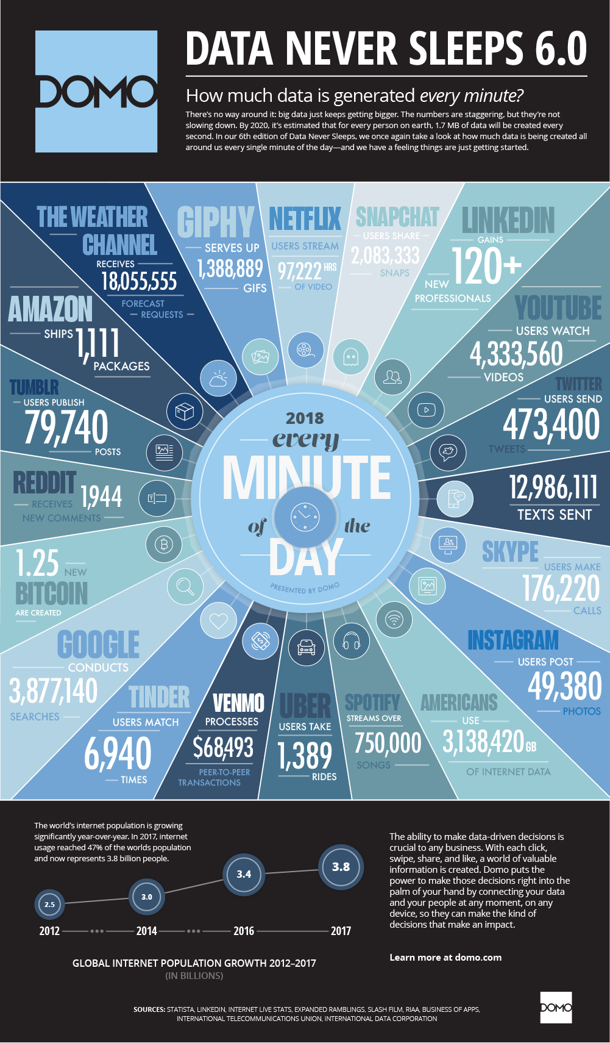
Data Never Sleeps

Slide 8
What is Big Data?
Big data is a term that describes the large volume of data – both structured and unstructured.
But it’s not only about the size of the data
Big data can be described by the three Vs:
Volume
Velocity
Variety

Slide 9
Big Data
Velocity: The quantity of generated and stored data.
Velocity: The speed at which the data is generated and processed
Variety: The type and nature of the data.
Extended Characteristic
Veracity: data quality and the data value

Slide 10
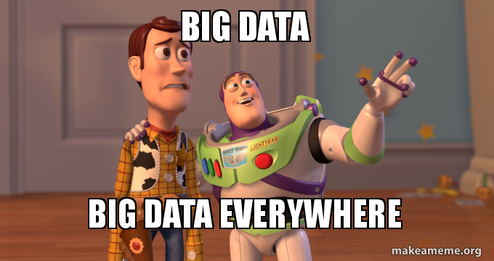
Big Data

Slide 11
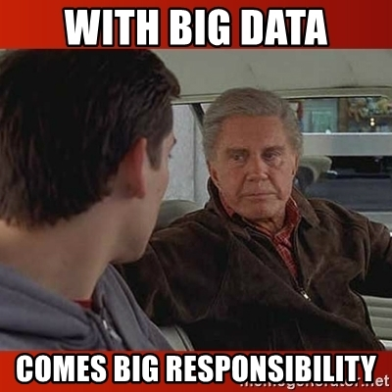
Big Data

Slide 12
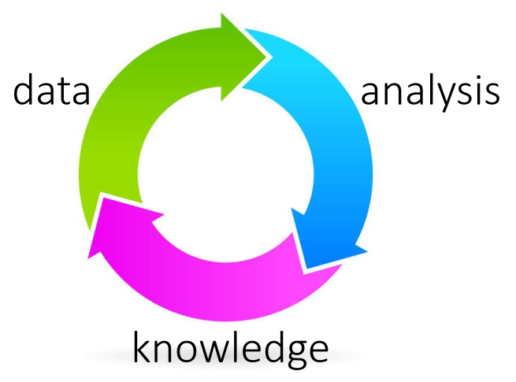
Big Data

Slide 13
Data Systems
A data system is a large software system (a collection of algorithms and data structures) that stores data, and provides the interface to update and access them efficiently.
The end goal is to make data analysis easy

Slide 14
Data Systems
“three things are important in the database world: performance, performance, and performance”
- Bruce Lindsay, IBM Research

Slide 15
Data Systems
We will discuss:
Relational/key-value storage/graph (not sure!)
Indexing
System architecture (row/column/hybrid)
Scale-up/scale-out

Slide 16
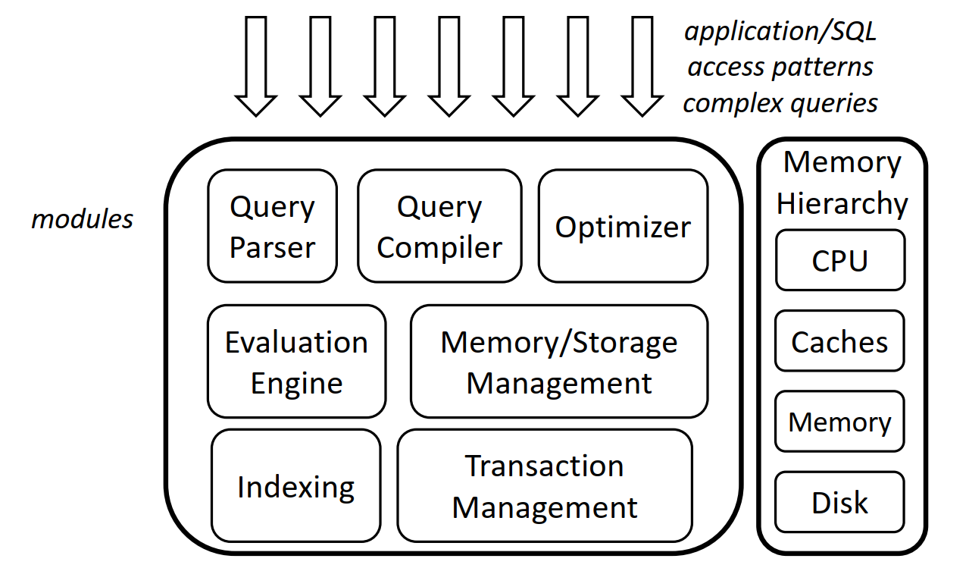
Data Systems

Slide 17
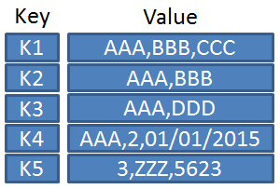
Key-Value Store
A key-value store, or key-value database is a simple database that uses an associative array (think of a map or dictionary) as the fundamental data model where each key is associated with one and only one value in a collection. This relationship is referred to as a key-value pair.

Slide 18
Key-Value Store
Simple data model that maps keys to a list of values
Easy to achieve
Performance
Fault tolerance
Heterogeneity
Availability
due to its schema-less data model and fine granularity partitioning of the data
Main operations: put, get, scan, range scan, count

Slide 19
Designing a Key-Value Store
What is the key/value?
Are they stored together?
Can read/write ratio change over time?
What to use? b-tree, hash-table, scans, skip-lists, zonemaps?
How to handle concurrent queries?
How to compress data?
How to exploit multi-core, SIMD, GPUs?
What happens if data does not fit in memory?
What happens if data does not fit in a node?

Slide 20
Designing a Key-Value Store
Other Challenges
Security
Scalability
Robustness
What happens when move to the cloud?

Slide 21
THANK YOU!!!

